Slide 1



Dr. Yin Mon Thant Professor Department of Statistics University of Co-operatives and Management, Sagaing
MAR PROGRAMME
STATISTICAL DEMOGRAPHY
MAR 113

Slide 2
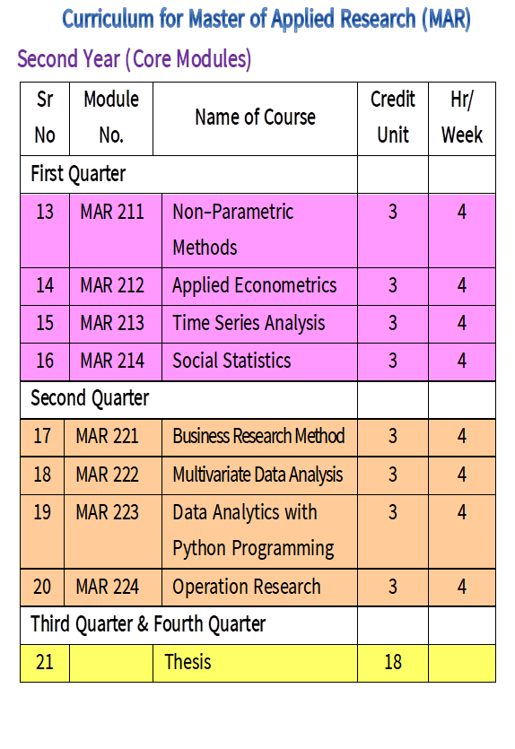

Slide 3
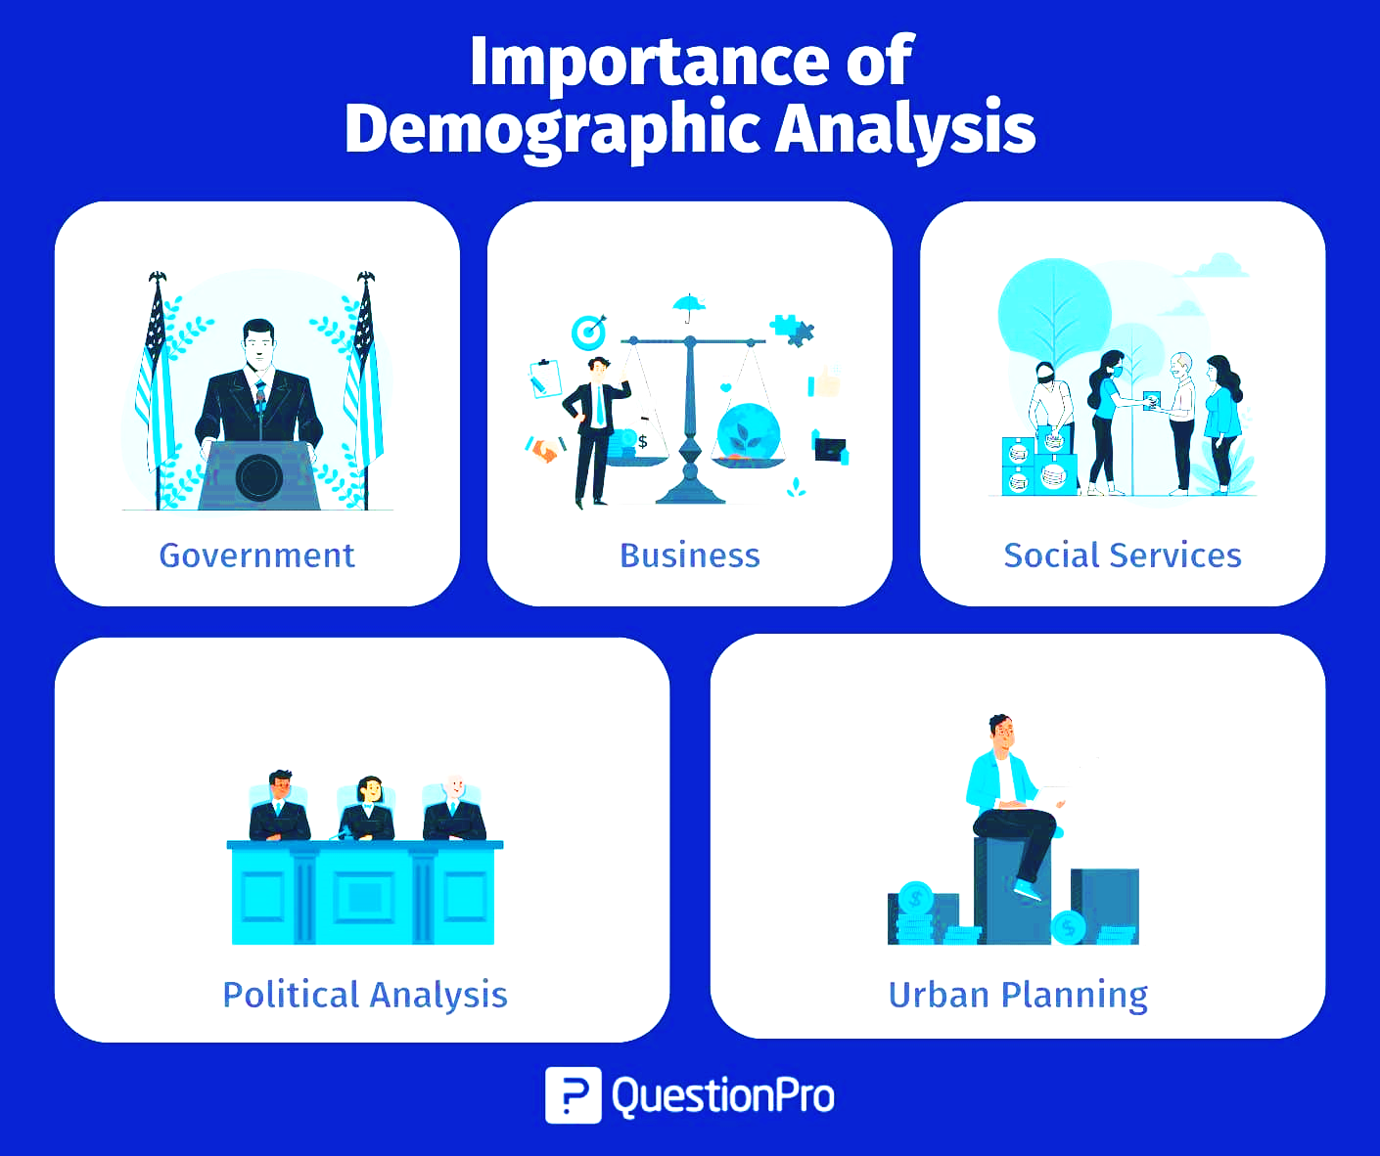

Slide 4

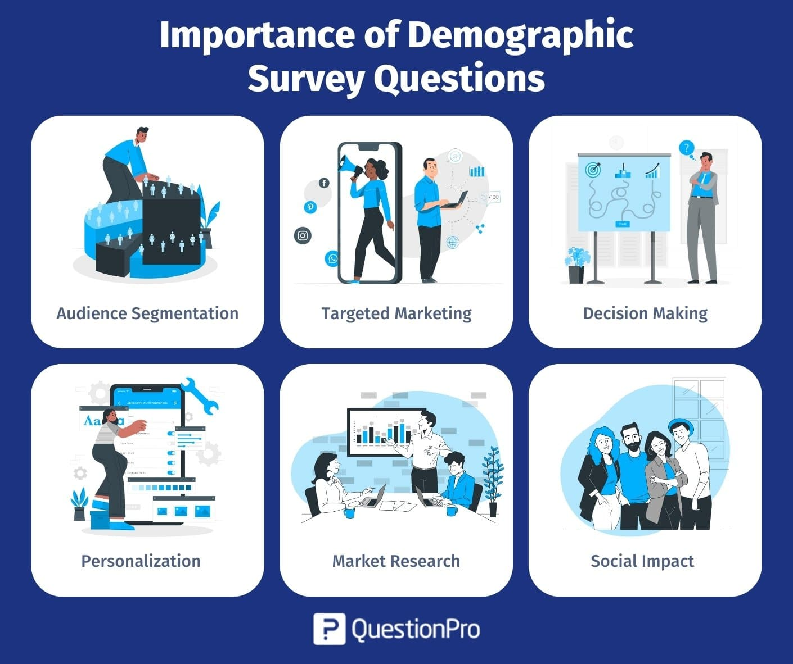
Demographic analysis is important because it provides valuable insights into population characteristics and trends, helping with informed decision-making in various fields like policy, marketing, and business.
It helps understand the makeup of communities, identify potential problems arising from population changes, and inform resource allocation for better service delivery.

Slide 5

MAR 113 Statistical Demography Objective to understand the basic demography data analysis and provides an understanding of the determinants of changes in the levels and trends of population and consequences of those changes.
Edu
Age
Race
Gender
Occup

Slide 6
Description
Definition of demography and population statistics. Scope and importance of demography. Data source and their limitations: census, vital registration system and survey. Structure of population pyramids. Evaluation of census data. Basic demographic indicators: population density, dependency ratio, sex ratio, child – women ratio. Estimation of population growth rates. Estimation of population. Basic measures of fertility, mortality and standardization techniques. Population projection for some ASEAN member countries and their experiences in urbanization, the economic problem: land, water, sea, sources of energy, the probability and distribution of food, the formation of working capital, the social problem: family life, freedom, work, savings, the medical problem: the risk to the mother, the problem of the unwanted child.

Slide 7

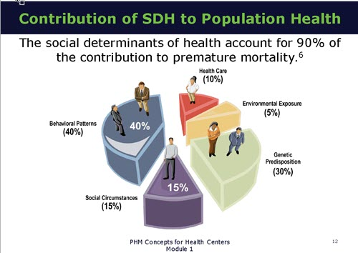
Understand the basics of demography.
Understand the core social demographic variables, and how these variables influence population growth, composition, and structure
Use demographic tools in understanding public health issues Knowledge attitude and practices.
Discuss global demographic regimes and impact on public health.
Identify appropriate sources of data, perform basic demographic analyses using various techniques and ensure their comparability across populations.

Slide 8
CONTENTS
UNIT 1
INTRODUCTION TO STATISTICAL DEMOGRAPHY
UNIT 2
SEX AND AGE
UNIT 3
MORTALITY
UNIT 4
FERTILITY
UNIT 5
POPULATION PROJECTION

Slide 9
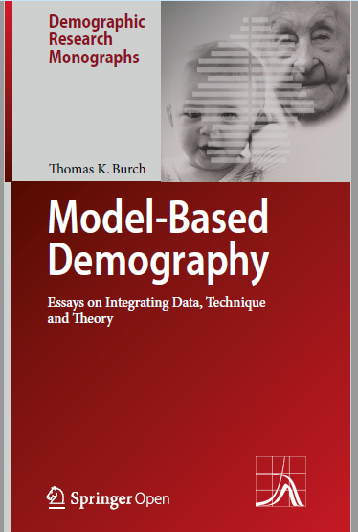




Others………

Slide 10
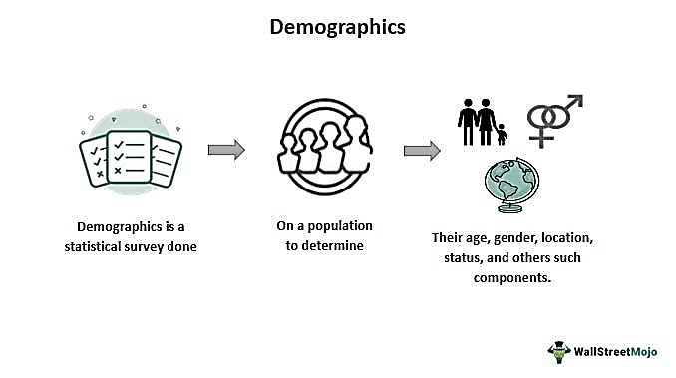

Slide 11
Meaning of Statistical Demography
Demography is the statistical study of human populations.
Demographers use census data, surveys, and statistical models to analyze the size, movement, and structure of populations.
Demography is the statistical study of human populations.
Demography examines the size, structure, and movements of populations over space and time.
It uses methods from history, economics, anthropology, sociology, and other fields.

Slide 12
Demographic statistics are measures of the characteristics of, or changes to, a population.
Records of births, deaths, marriages, immigration and emigration and a regular census of population provide information that is key to making sound decisions about national policy.

Slide 13
The five demographics include age, gender, religion, income, and education.
There are a few other main demographics that are commonly used, combining multiple demographics.
Demographic information examples include: age, race, ethnicity, gender, marital status, income, education, and employment.
These are referred to as the family life cycle and socio-economic status.

Slide 14
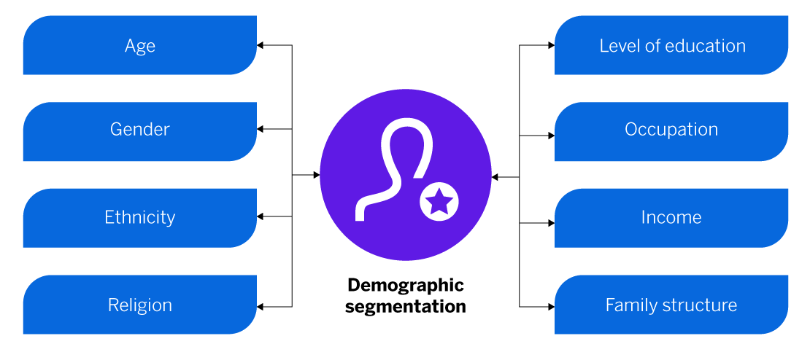

Slide 15
The most common demographic categories that small business owners should gather include:
Age
Gender
Race
Marital status
Number of children (if any)
Occupation
Annual income
Education level
Living status (homeowner or renter)

Slide 16
Sources of Population Data
The main sources of population statistical data are:
censuses,
sample surveys, and
registration of migration and vital events such as births, deaths, marriages, and divorces.

Slide 17

Hank you for your Attention

